Slide 1
NutriWeb
Project: Java and Web Development
Phase 2
https://github.com/mattiagemmiti/NutriWeb
https://nutriweb-4ac556da0058.herokuapp.com/
Name: Mattia Gemmiti
Program: BSc. Computer Science
ID: 92128537
Course: DLBCSPJWD01
Exam: Portfolio
Tutor: Christian Remfert Date: September 4th, 2024
1
Notes:
1

Slide 2
Purpose of the app:
This web-based application is designed to enhance dietary well-being by enabling users to track their daily food intake and nutrient absorption, such as total calories, fibers, proteins, etc. The platform also provides a unique interface for nutritionists, who can register and log in to monitor and advise users based on their dietary habits.
Key Features:
User Registration and Authentication: Implements a secure system for user and nutritionist registration and login.
Food Logging: Allows users to record food items and their corresponding caloric and nutritional content.
Progress Tracking: Users can monitor their calorie and nutrient intake on a daily basis.
Nutritionist Dashboard: Enables nutritionists to view client food logs and deliver personalized nutritional advice.
2
Notes:
2

Slide 3
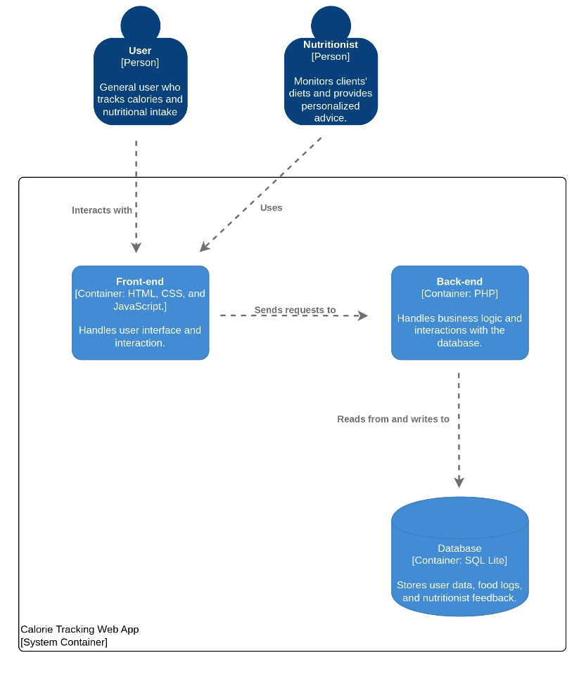
Architecture Diagram of the Project:
3
Notes:
3

Slide 4
Overview of technology choices for front and backend:
Front-End Technologies: HTML, CSS: Provides the structure and styling of the web application. Bootstrap: Ensures responsiveness across all devices. JavaScript: Adds interactivity and handles dynamic user interactions. Back-End Technologies: PHP: Manages server-side logic, processes user requests, and communicates with the database. SQLite: Utilizes a simple .db file created and managed via PHP scripts for storing user data and food logs. System Integration: JavaScript: JavaScript uses AJAX to handle user interactions dynamically, sending data to PHP scripts without needing full page reloads. PHP and Database Interaction: PHP scripts process these AJAX requests and interact with the SQLite database file to perform data retrieval, storage, and updates, enabling real-time modifications on both user and nutritionist dashboards.
4
Notes:
4

Slide 5
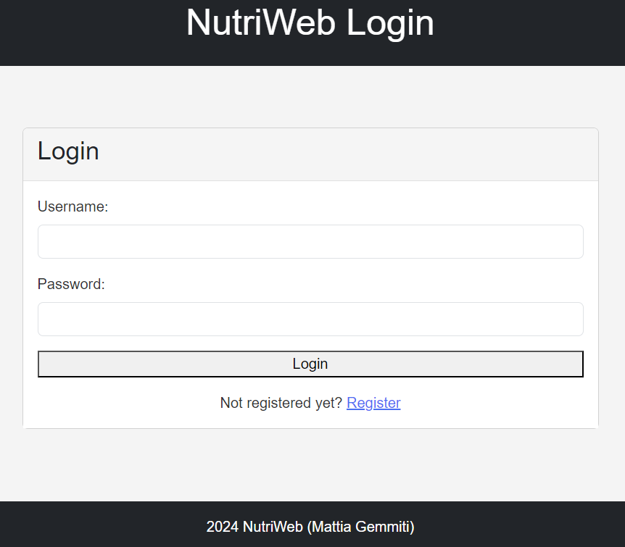
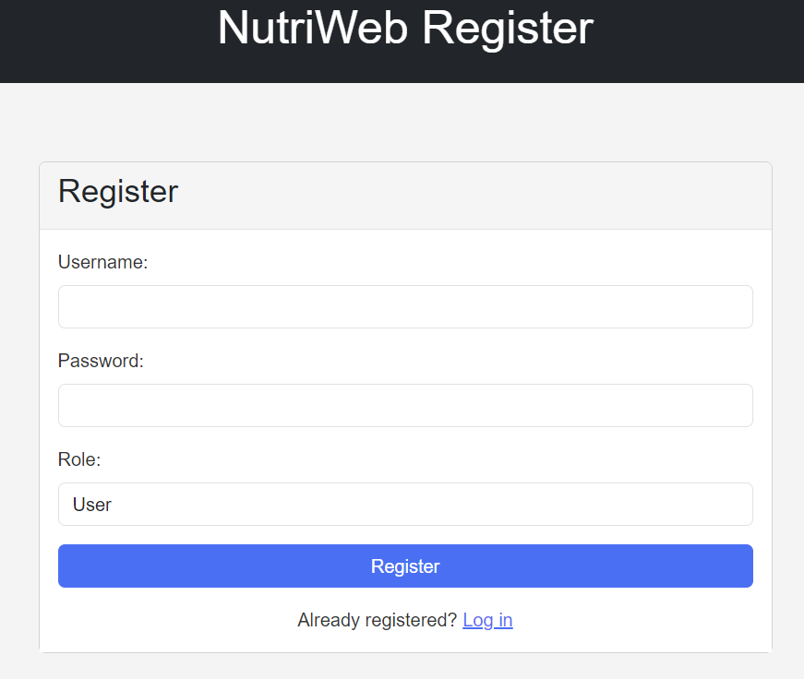
SCREENSHOTS OF THE WEB APPLICATION:
Login Page: From this page, it is possible to log in if you already have an account. If your account is registered as a user, you will be redirected to your user page. If you are a nutritionist, you will see the nutritionist's dashboard.
Registration Page: Here, you can register as a user or nutritionist, depending on the role you will have in the app.
5
Notes:
5

Slide 6
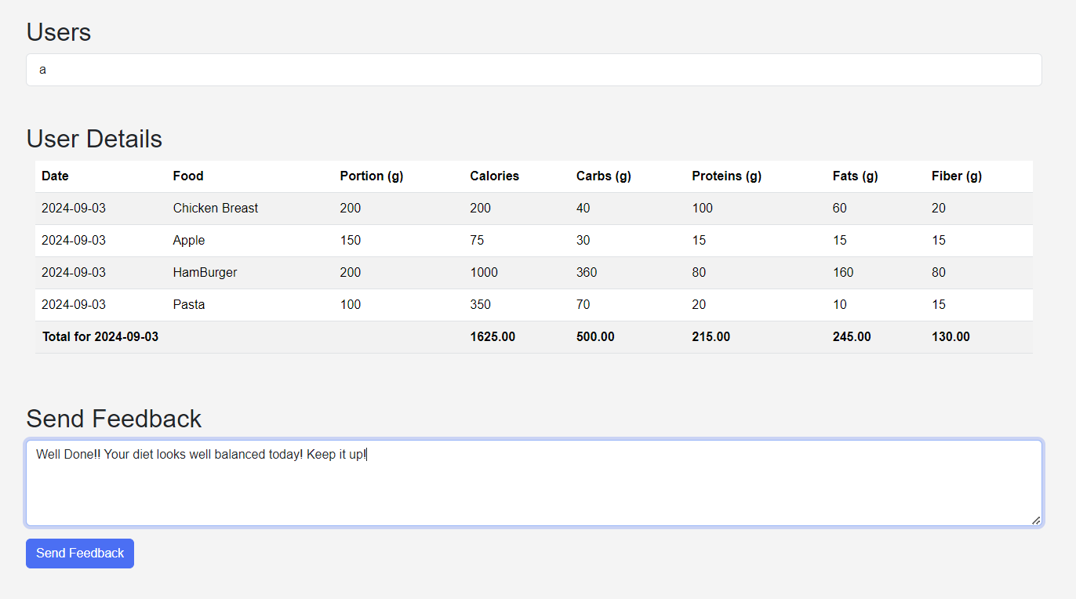
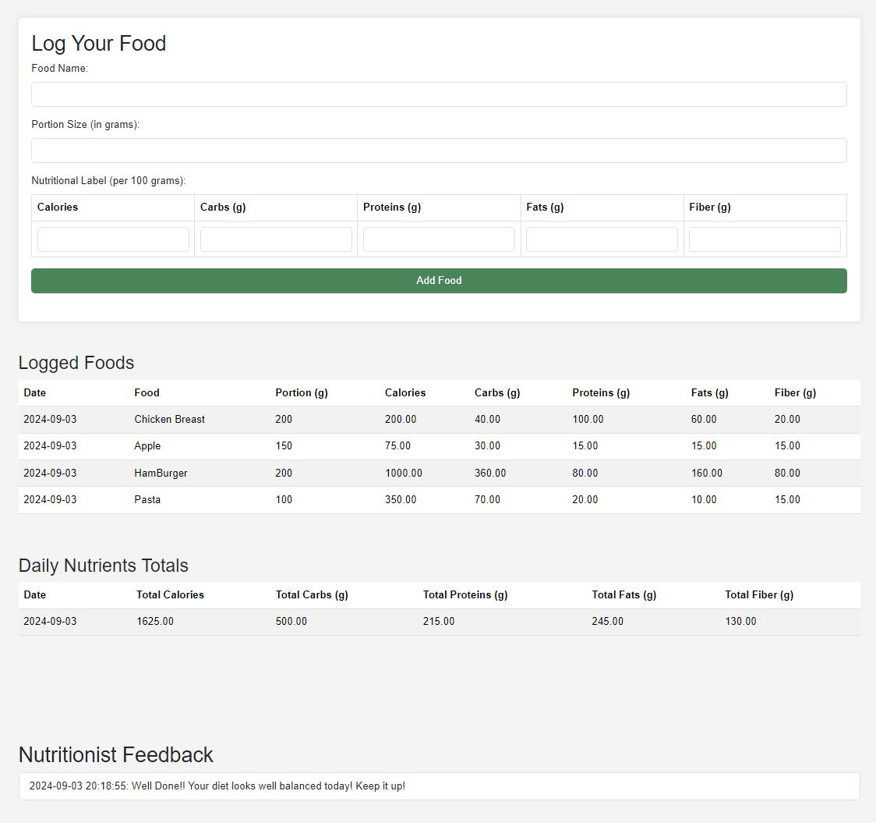
Nutritionist Dashboard: This dashboard displays a list of users. By clicking on any user, you can view their food log. For each day, a daily nutrient summary is presented as the last row. Additionally, at the bottom, there is a window for sending personalized feedback and advice to the selected user.
User Dashboard: Here, users can log their food and view a daily summary to help keep their intakes under control. Additionally, messages from the nutritionist are delivered and displayed at the bottom of the page.
6
Notes:
6

Slide 7
Test Cases:
Test Case 4: Accessing normal user dashboard
Initial Condition: The user is logged in and can add food to their list and view nutritionist’s feedbacks.
Steps:
The user navigates to the food log page.
The user enters a new food item (name, portion size, calories, etc.).
The user clicks "Add Food."
Expected Result:
The food item is successfully added to the log, and the updated food log is displayed both on their dashboard and nutritionists’ dashboard.
User can view nutritionist’s feedback at the end of the page
Test Case 5: Attempt to Add an Invalid Food Entry
Initial Condition: The user is logged in.
Steps:
The user navigates to the food log page.
The user enters an invalid food item (e.g., missing name or portion size).
The user clicks "Add Food."
Expected Result: An error message appears: "Please fill out this field!"
Test Case 6: Accessing the Nutritionist Dashboard
Initial Condition: The user is logged in as a registered nutritionist.
Steps:
The nutritionist logs into the system.
The nutritionist navigates to the dashboard.
The dashboard displays a list of clients.
The nutritionist clicks on a client's name to view their food log.
The nutritionist clicks the "Send Feedback" button after reviewing the food log.
A confirmation message appears: "Feedback sent successfully."
Expected Result:
The nutritionist dashboard is displayed with a list of clients.
Upon selecting a client, their food log is displayed.
After clicking "Send Feedback," the feedback is successfully sent, and a confirmation message is shown: "Feedback sent successfully."
Test Case 1: Successful User Registration with Valid Data
Initial Condition: No user with the given credentials exists in the system.
Steps:
The user navigates to the registration page.
The user enters valid data (username, password, role).
The user clicks on "Register."
Expected Result: The user is successfully registered and allowed to log-in.
Test Case 2: Successful Login with Correct Credentials
Initial Condition: The user is already registered.
Steps:
The user navigates to the login page.
The user enters a valid username and password.
The user clicks on "Login."
Expected Result: The user is redirected to the user or nutritionist dashboard ( the redirect is automatically role-based ).
Test Case 3: Login Attempt with Incorrect Credentials
Initial Condition: The user is registered but enters an incorrect username or password.
Steps:
The user navigates to the login page.
The user enters the correct email but the wrong password.
The user clicks on "Login."
Expected Result: An error message appears: "Invalid username or password!"
Notes:
7

Slide 8
Project Overview and Changes Made: Overall, the implementation adheres closely to the initial proposal from the conceptual phase. To simplify the process and enhance clarity, weekly and monthly reports to the nutritionist were replaced by a daily summary row. This change helped eliminate redundant JavaScript functions and kept the script concise.
No other changes were made to the original plan; the architecture of the web application and the technologies used remain as initially proposed.
Limitations of the Project: Registration Controls: the ability for users to register as nutritionists is not regulated, allowing unrestricted access to all user data. This approach is not suitable for a real-world application where professional credentials and privacy concerns must be managed. Database Management: the project uses a .db file generated with the init_db.php script as database. While this is functional for educational purposes, it would not meet the security and scalability requirements of a commercial application. Deployment: The project is also hosted on Heroku, which supports both front-end and back-end components. However, it's important to note that Heroku's ephemeral filesystem leads to periodic database resets. Therefore, data, including user credentials, are not permanently stored and may be reset at intervals by the platform. This setup is intended solely for illustrative and educational purposes.
8
Notes:
8

Slide 9
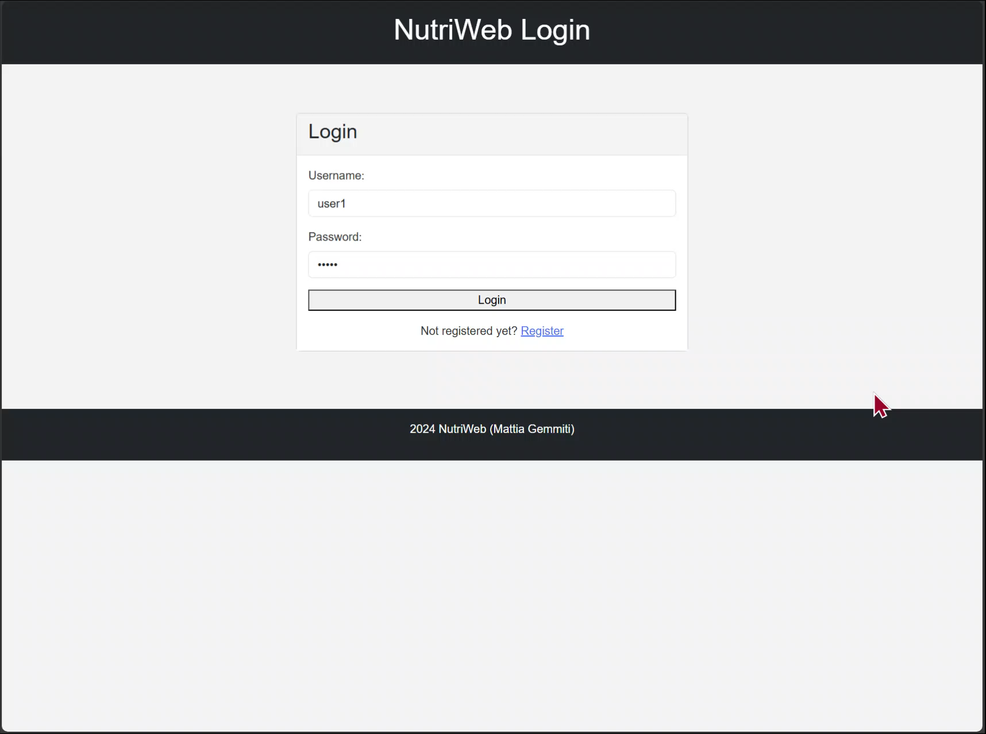
SCREENCAST VIDEO OF THE APPLICATION:
9
Notes:
9

Slide 10
Thank you
Mattia Gemmiti
https://nutriweb-4ac556da0058.herokuapp.com
https://github.com/mattiagemmiti/NutriWeb
Notes:
10

